Slide 1
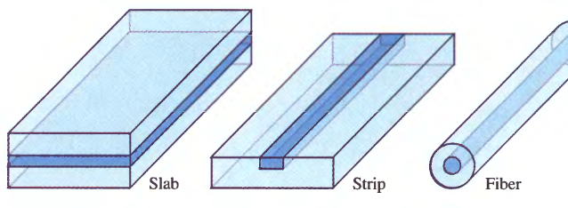
Optical Waveguides for Integrated Optics
Waveguides:
Confine Light in 1 or 2 Dimension(s)
Propagate Light in 1 Dimension

Slide 2
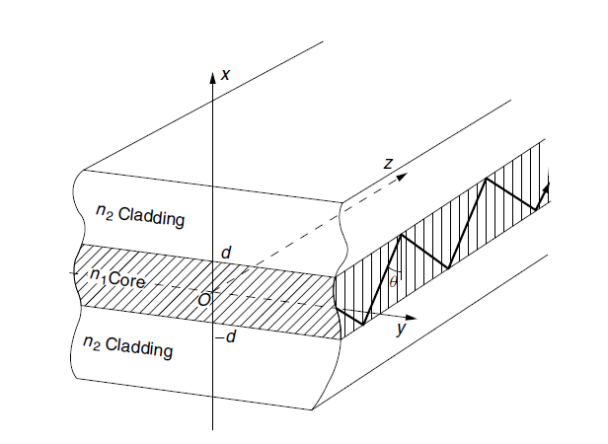
planar optical waveguide
The foundation of integrated optics is the planar optical waveguide.

Slide 3
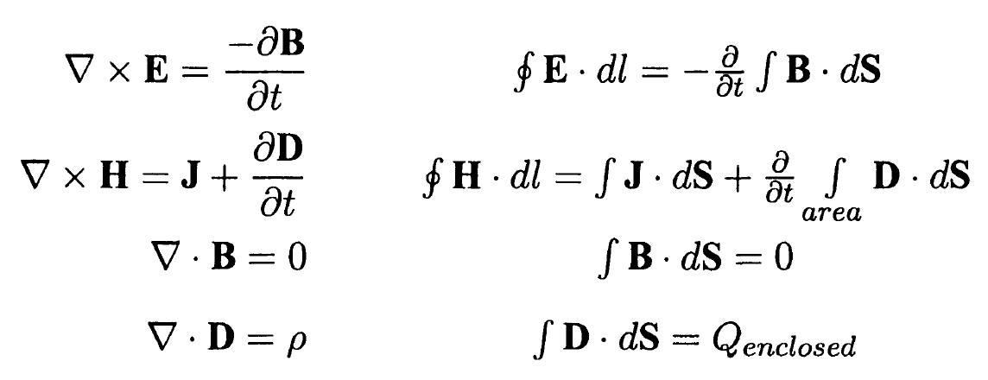
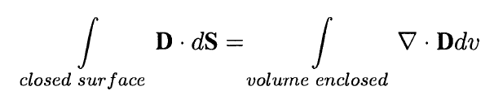
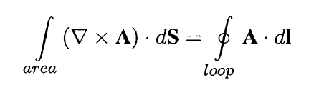
Geometrical Optics,
light will propagate by total internal reflections
This simple geometrical optics theory fails when the dimensions of the guiding medium are comparable to the wavelength of the light. In this regime, the guide supports propagation only for a discrete number of angles, called modes of propagation.
Electromagnetic Optics

Slide 4
Assumptions
Symmetric Waveguide
The infinity of the y dimension → ∂/∂y=0
(No component of the field varies in the y direction)
3. The solutions are separated into two waves:
One that has only transverse and no longitudinal magnetic field, Hz=0, Hx=0. (TM Modes)
The other that has only transverse and no longitudinal electric field, that is, Ez=0, Ex=0. (TE Modes)

Slide 5



TM Modes Solution
a) Helmholtz Equation
λ is the wavelength in vacuum
Is applicable for both core and cladding layers by using the respective values of n1 or n2 for n1,2.
b) TM Modes → Hz=0, Hx=0.
c) Guiding wave shape

Slide 6
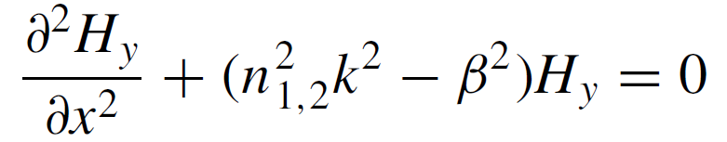









Solution of Equation
→
→
→
In Core:
In Cladding:

Slide 7
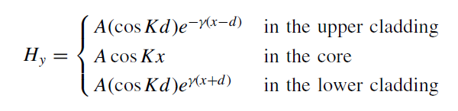
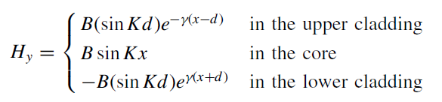
Solution of Equation
Boundary Condition at x=-d and x=d results for even modes:
And for odd modes:

Slide 8
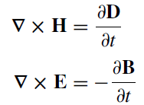
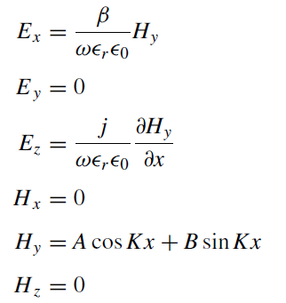
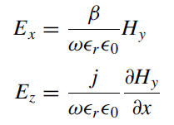
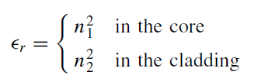
Solution of Equation
Ex and Ez are obtained from Hy using Maxwell’s equations:

Slide 9



Characteristic Equation
Boundary condition of the even TM modes gives for Hy at x=d:
Boundary condition of the even TM modes gives for Hz at x=d:
Dividing first equation by second gives Characteristic Equation for Even modes:

Slide 10



Graphical solutions for the TM modes
→
Graphical solutions are available:
&
Characteristic Equation for Odd modes (in the same manner):

Slide 11
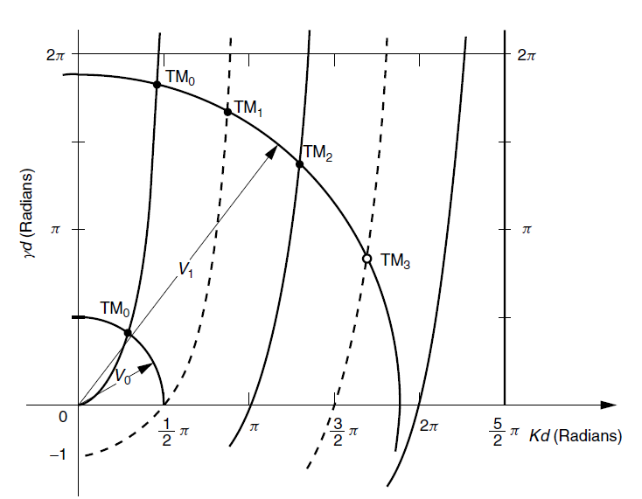
Graphical solutions for the TM modes
Characteristic Equation for Even modes (solid lines):
Characteristic Equation for Odd modes (dashed lines):
Circles
Graphical solutions for the even TM modes in solid lines, and odd TM modes in dashed lines. Plotted on the Kd–γd plane.

Slide 12
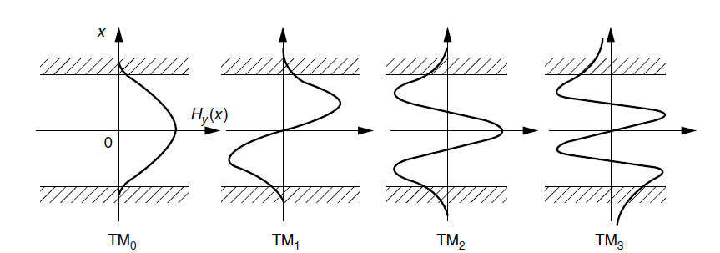
TM modes Field distributions

Slide 13

Description
The order of the mode or the mode number
Cutoff of the mode
Evanescent wave (Max at Cutoff )
Single mode waveguide
Dominant mode (TM0 mode)
Multi mode Waveguide
Mode dispersion
If → The total number of TM modes including the zero-order mode is N + 1

